Slide 1
Instructions (delete this slide)
Save this document with a new name before you begin work.
When adding a new slide, click on the small arrow next to “New Slide” on the toolbar. Select the layout that will best fit the content you want to add.
Change the layout of an existing slide: click the “Layout” button on the top toolbar to reformat your existing content to another master slide.
The dashed lines on the slide are guides. If you prefer to turn them off, go to the View menu, down to Guides and uncheck Guides.
Refer to utdallas.edu/brand for specific rules on using the University logos and wordmarks.
UTD_Light.pptx

Slide 2

D&D Optimal Combat Encounter
Alyssa Vellucci, Jonas Wagner
MECH 6326: Optimal Control & Dynamic Programming
Spring 2023
Notes:
Save this document with a new name before you begin work.
When adding a new slide, click on the small arrow next to “New Slide” on the toolbar. Select the layout that will best fit the content you want to add.
Change the layout of an existing slide: click the “Layout” button on the top toolbar to reformat your existing content to another master slide.
Refer to utdallas.edu/brand for specific rules on using the University logos and wordmarks.

Slide 3
D&D Optimal Combat Encounter
Introduction
Model & Problem Formulation
Feedback Control Design
Numerical Experiments
Conclusions

Slide 4
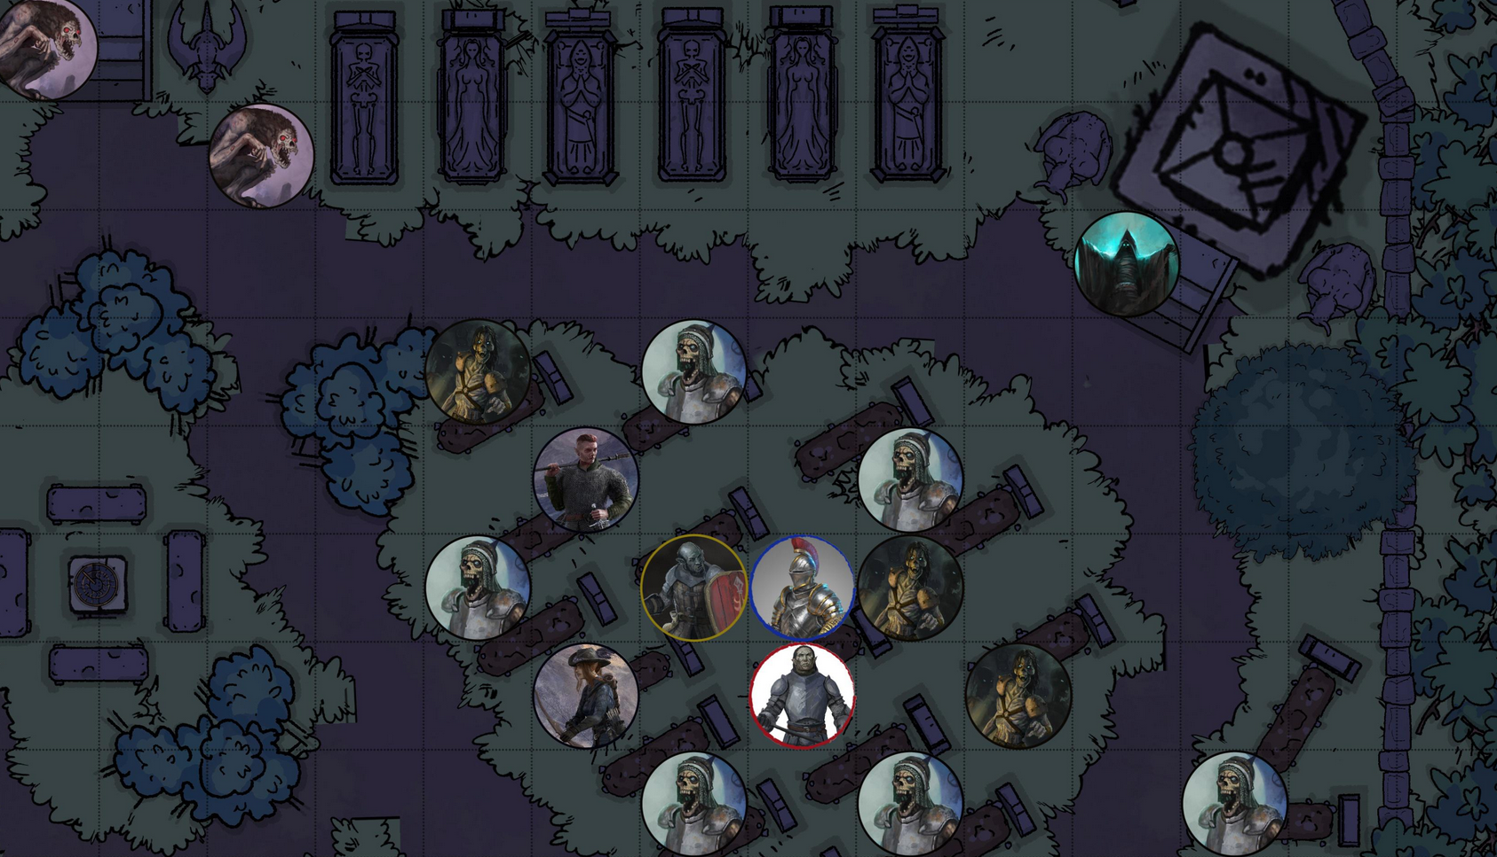
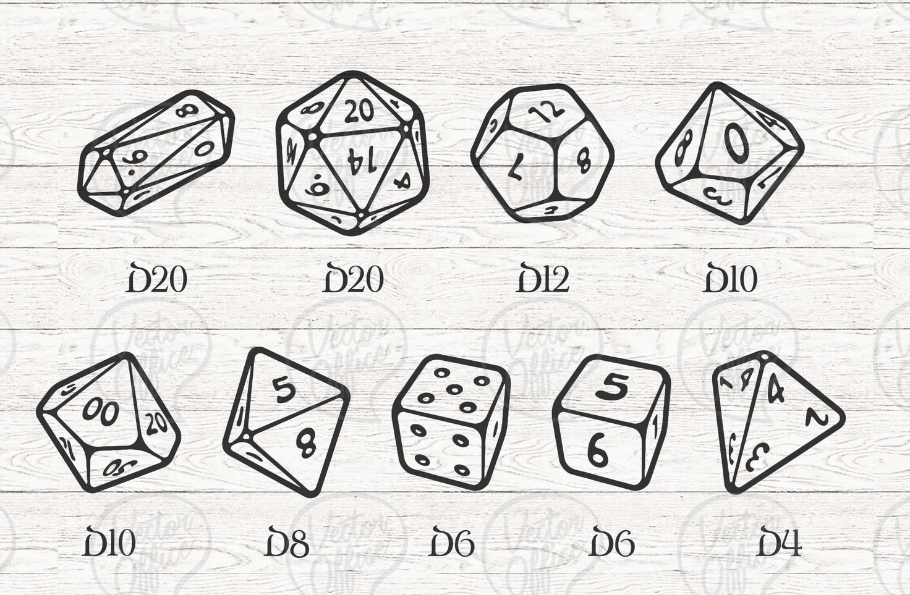
Introduction
D&D Optimal Combat Encounter
Dungeons & Dragons (D&D) is a tabletop roleplaying game.
Combat encounters consist of an enemy (monster) and player characters (PCs). The PCs want to defeat the monster and remain alive themselves. The success of their actions is determined by a dice roll.
General process for a combat encounter:
Player moves their PC on the battle-map
Player chooses an action to perform (weapon attack, health potion, etc.)
Player rolls required dice to determine the outcome of that action
Motivation: Given a dynamic combat scenario, what are the optimal actions to take to ensure success?
https://www.reddit.com/r/DungeonsAndDragons/comments/nozopn/free_vtt_token_generator_and_battle_maps_for_your/
https://www.etsy.com/listing/813121763/bundle-dnd-dice-svg-dungeons-and-dragons

Slide 5
Problem Constraints
D&D Optimal Combat Encounter
D&D 5e Combat Rules | D&D Combat for Dynamic Programming
PCs can move at any point in their turn | PC moves at the start of their turn
PCs can move an amount equal to their “movement speed” per turn | PC moves one grid block per turn
PC can perform spells according to their class and number/level of spell slots | PC cannot perform spells
PC can perform non-attack actions (i.e. grapple, help, disengage, etc.) | PC cannot perform non-attack actions
PC can interact with the environment (set traps, tie ropes, etc.) | PC cannot interact with environment
Footer information

Slide 6
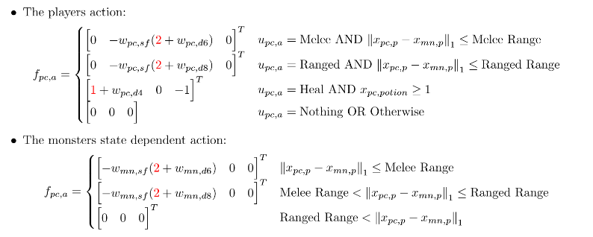
Problem Formulation
D&D Optimal Combat Encounter
D&D Combat for DP Ruleset:
1 monster, 1 player character
Same weapon dice, health, and movement
Movement:
PC will move at the start of its turn, then perform an action
Monster will always move toward the player
Movement includes up, down, left, right
Combat:
PC and monster can perform one melee or ranged attack per turn
PC can perform one heal action, monster cannot heal
PC and monster can choose to do nothing on their turn
No ability modifiers for PC or monster
Dice roll +0 for melee and ranged attacks
Attack ranges:
Melee: 1 block
Ranged: 2 blocks
Footer information

Slide 7
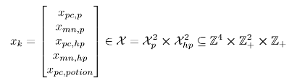
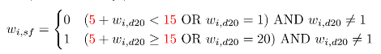
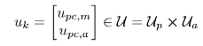
Model Formulation
D&D Optimal Combat Encounter
The states of the system include:
Current position of PC
Current position of monster
Current HP of PC
Current HP of monster
Potion availability (PC only)
The inputs to the system include:
PC Direction of movement
PC Melee attack
PC Ranged attack
PC heal
Nothing
The dice used are d4, d6, d8, and d20 dice. These create the stochastic disturbance in the system. The success or failure of the input is defined as:
The monster’s inputs are state-dependent in that it will always try to move toward the PC. It will always use a melee attack if it’s close enough, and a ranged attack if it’s further away.

Slide 8
Dynamic Programming Process
D&D Optimal Combat Encounter
1. Define Markov Chains from given problem parameters
2. Update the Markov probability matrices for each input at each location in the grid
3. Simulate the system with an “infinite” time horizon and update the system at every time step

Slide 9
Column chart (single category)
Displaying data
Callout example
Callout example
Right-click the chart and select “Edit Data in Excel” to customize the values.
Footer information

Slide 10
Column chart (multi-category)
Displaying data
Callout example
Callout example
Right-click the chart and select “Edit Data in Excel” to customize the values.
Footer information

Slide 11
Stacked column chart
Displaying data
Callout example
Callout example
Right-click the chart and select “Edit Data in Excel” to customize the values.
Footer information

Slide 12
Bar chart
Displaying data
Callout example
Callout example
Right-click the chart and select “Edit Data in Excel” to customize the values.
Footer information

Slide 13
Line chart
Displaying data
Callout example
Callout example
Right-click the chart and select “Edit Data in Excel” to customize the values.
Footer information

Slide 14
Pie chart
Displaying data
Callout example
Callout example
Right-click the chart and select “Edit Data in Excel” to customize the values.
Footer information

Slide 15

“We are incredible at remembering pictures. Hear a piece of information, and three days later you’ll remember 10 percent of it. Add a picture and you’ll remember 65 percent.”
John Medina
Author of Brain Rules
Notes:
You can leave this background orange or add a subtle background photo using the directions from the title slide. Right-click on the image and select Change Picture to switch out the image.

Slide 16
“We are incredible at remembering pictures. Hear a piece of information, and three days later you’ll remember 10 percent of it. Add a picture and you’ll remember 65 percent.”
John Medina
Author of Brain Rules
Notes:
You can leave this background orange or add a subtle background photo using the directions from the title slide. Right-click on the image and select Change Picture to switch out the image.

Slide 17
Quote slide style example layout. Text should be sentence case.
First, Last Name
Company name
Title comes here
Notes:
Quote slide without photo background

Slide 18
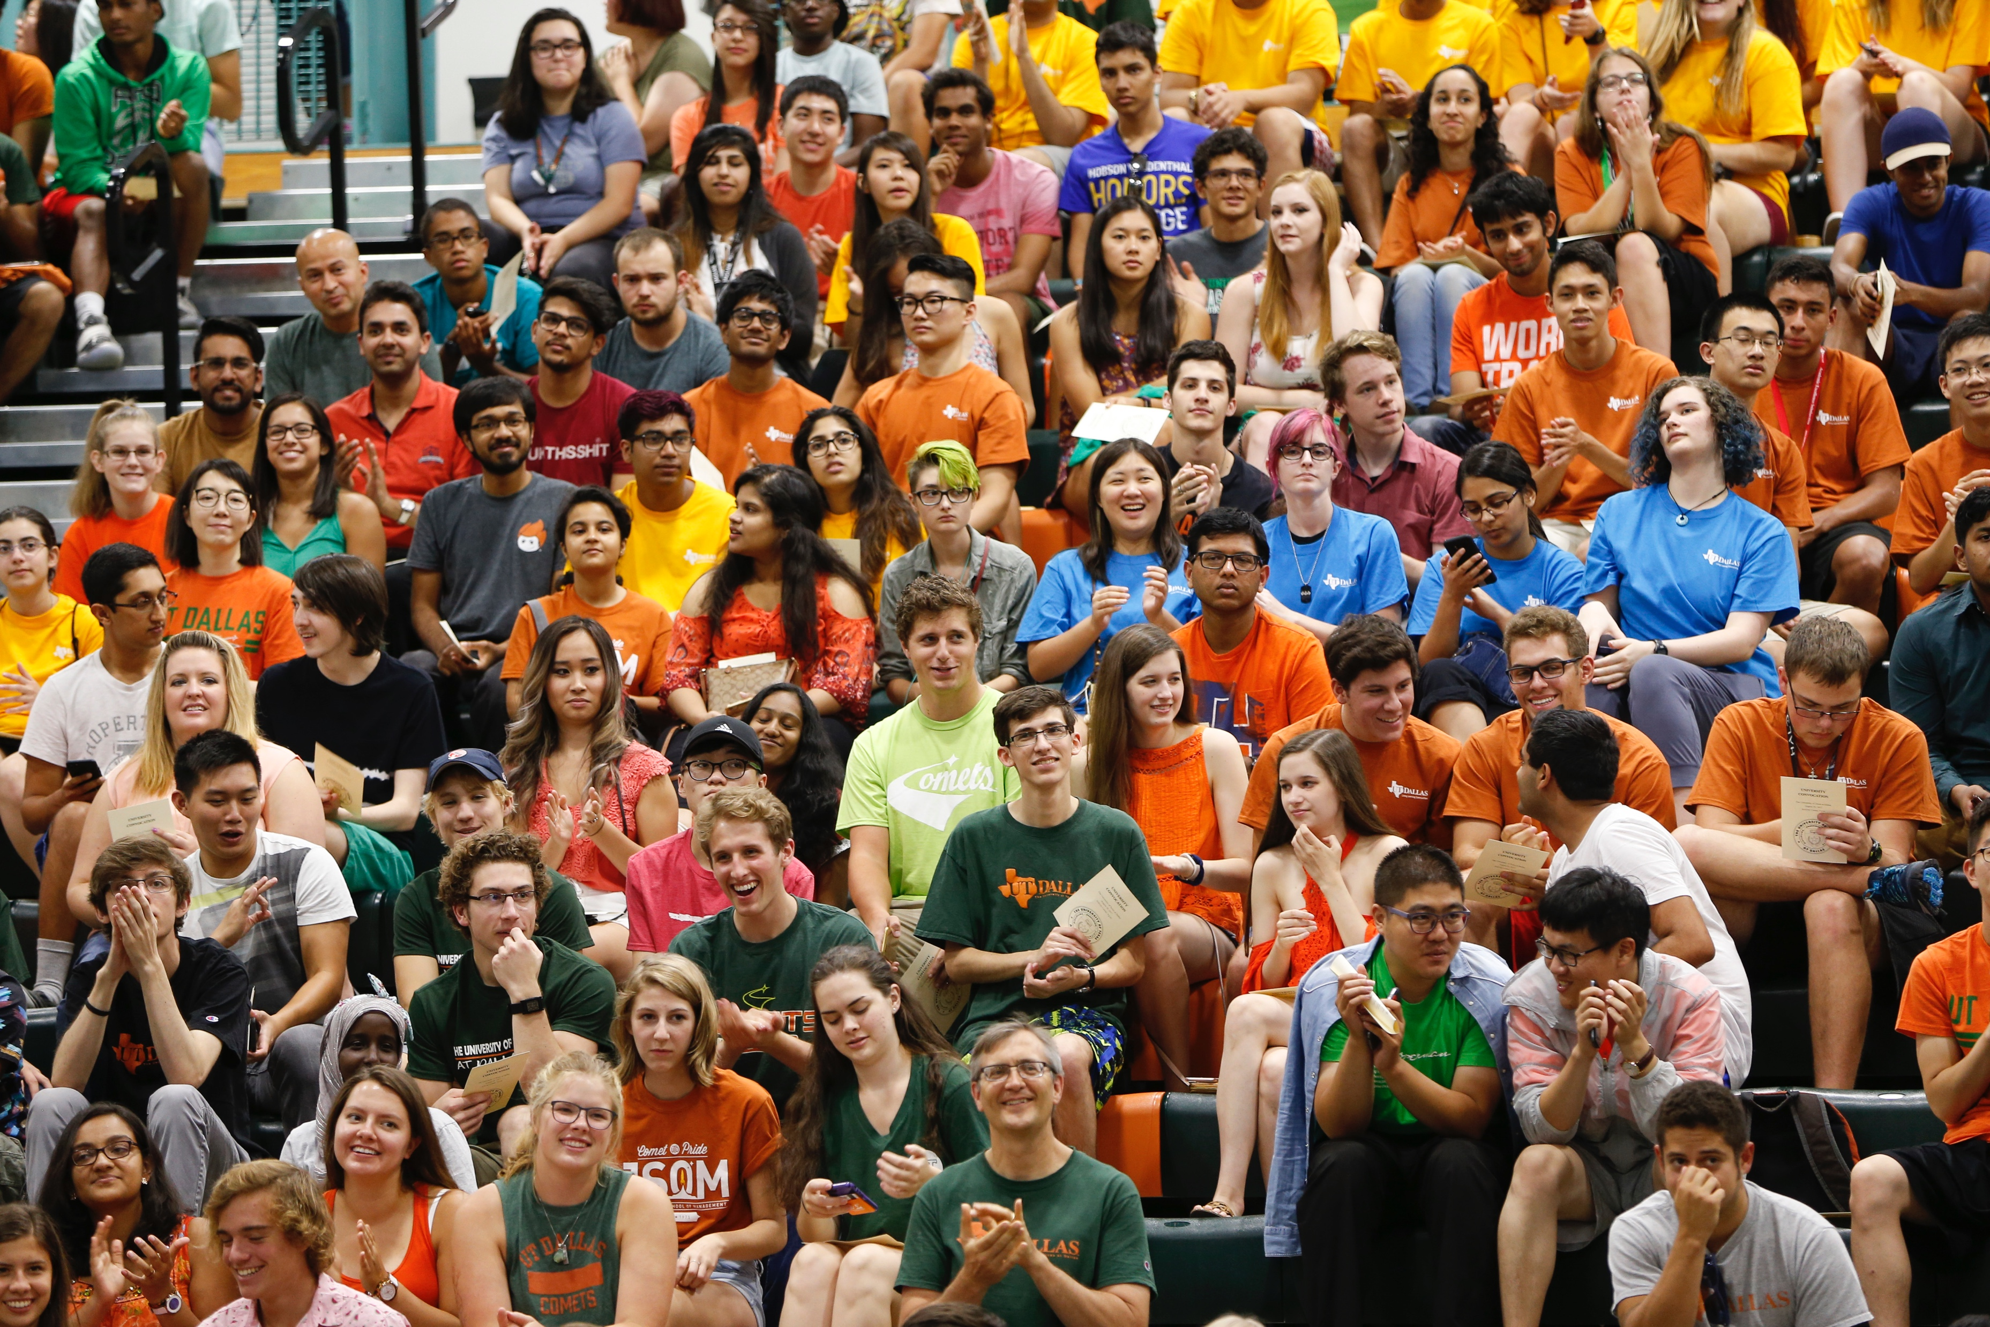
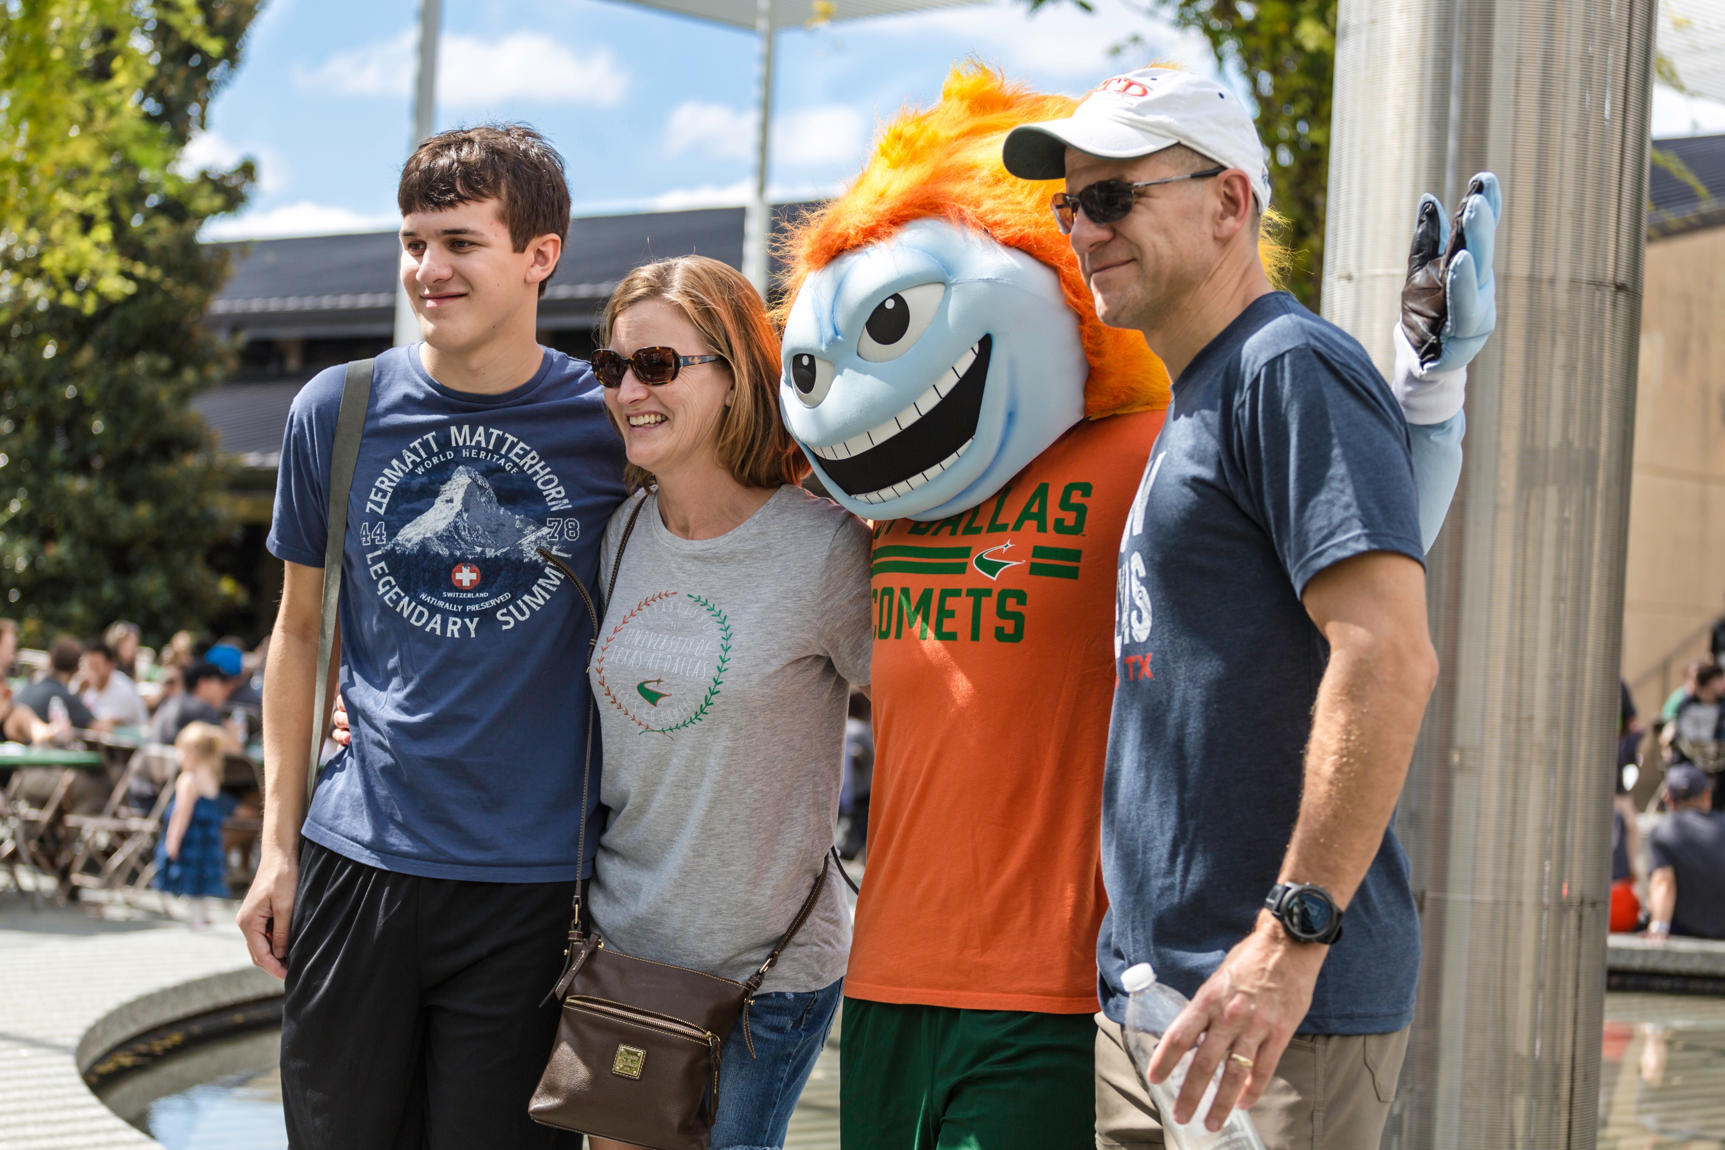
UT Dallas Enrollment
Our student body has seen a 163% increase in 9 years.
Footer information
Notes:
Example Slide – 3 columns

Slide 19
UT Dallas Enrollment
Upward Trajectory: example slide
Our student body has seen a 163% increase in 9 years
Footer information
Notes:
Example Slide – 2 columns

Slide 20
Callout style examples
Text Here
Text Here
Text Here
Text Here
Text Here
Text Here
Text Here
Text Here
Footer information
Notes:
Copy and paste these onto various slides to highlight main points

Slide 21








UT Dallas Marks

Slide 22
Section head
Overview of the section
Use to segue to another section
Use as a Q&A slide

Slide 23
Contact information or summary
More details concerning the brand standards for UT Dallas can be found online at utdallas.edu/brand.
Thank you

